Slide 1
The Science of Insecurity
Len Sassaman Meredith L. Patterson Sergey Bratus

Slide 2
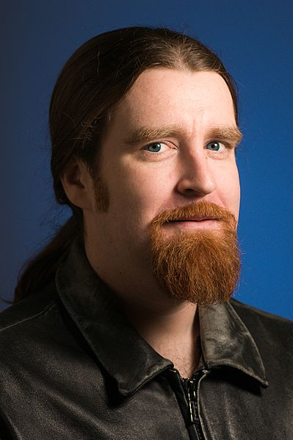
Tribute to Len Sassaman
Anonymity/privacy researcher, cypherpunk
Moved to language-theoretic security in 2009
Because the future of an open Internet depends on smoothing out the attack surface
1980 - 2011
Notes:
MEREDITH
Len -> KUL researcher (anonymity/privacy), moved to langsec in 2009 because the future of an open Internet depends on smoothing out the attack surface

Slide 3
Insecurity is the “new normal”
“Treat all systems as compromised”
“There's no such thing as ‘secure’ any more.” -- Deborah Plunkett, NSA Information Assurance Directorate
“Long weeks to short months before a security meltdown” – Brian Snow, in December 2010
“are we there yet?” You bet we are, unless one agrees to view LulzSec as “APT”/nation state
Notes:
MEREDITH
We’ve been living on borrowed time

Slide 4
Not for lack of trying
Various “trustworthy computing” initiatives
Lots of “secure coding” books
Mounds of academic publications
New hacker-developed testing methods: fuzzing, RE-backed binary analysis …
Yet software still sucks!
And hardware – we don’t even know how much it sucks (no tools to poke its attack surface -- yet)
Notes:
MEREDITH

Slide 5
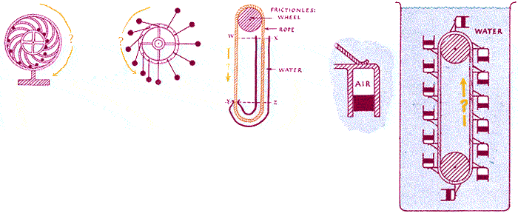
There must be something we are doing wrong
Science to engineers: some problems are not solvable, do not set yourself up to solve them
“There is a law of nature that makes it so, no matter how hard you try”
Notes:
MEREDITH
Laws of physics, laws of mathematics. Our “physicists” are Russell, Godel, Turing – tried to universalise mathematics from axioms. The problem we as security researchers want to solve is a bit more focused than the problem they wanted to solve. But we start in the same way, namely formalising the question…

Slide 6
What is INsecurity?
Holes for sneaking in executable code?
“Malicious code” has been deprecated for “malicious computation” (since 2000 by hackers, since 2007-8 by academia – a lesson of ROP)
Memory corruption?
In-band signaling?
Exposing unnecessary privilege?
All of the above?
Notes:
SERGEY

Slide 7



Wikipedia on Causes of Vulnerabilities
Vulnerability (computing)
Complexity
Familiarity
Connectivity
Password management flaws
Fundamental OS flaws
Internet Website Browsing
Software bugs
Unchecked user input
Not learning from past mistakes
Notes:
SERGEY
And so one is left scratching one’s head: what to do about all these? What’s going to bite next?
If the classification looks a bit arbitrary, this means the structure/common origin of phenomena is not fully understood

Slide 8
Vulnerability classifications?
[In] a certain Chinese encyclopaedia … the animals are divided into: (a) belonging to the emperor, (b) embalmed, (c) tame, (d) suckling pigs, (e) sirens, (f) fabulous, (g) stray dogs, (h) included in the present classification, (i) frenzied, (j) innumerable, (k) drawn with a very fine camelhair brush, (l) others, (m) having just broken the water pitcher, (n) that from a long way off look like flies. --- Jorge Luis Borges, “The Analytical Language of John Wilkins”
Notes:
SERGEY
AS: Too verbose. Make the header something like: “Classifying vulnerabilities” . Next, “According to a certain Chinese encyclopaedia…, the animals are divided into:”
‘Celestial Empire of benevolent Knowledge’ …

Slide 9
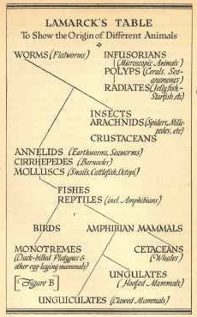
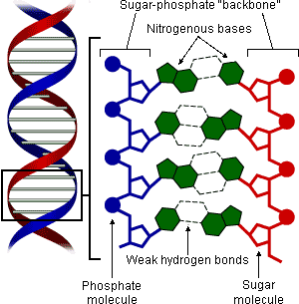
Nature and origins of insecurity:
Need a leap from “Lamarck” to “Watson and Crick”
Notes:
MEREDITH
It’s true that we can and *should* classify exploits by similarity, but we’re setting ourselves up for failure if we only look at surface similarity and not underlying/structural similarity. Cladistics, bitches!

Slide 10

Insecurity is inseparable from computation
Trustworthiness of a computer system is what the system can and cannot compute
Can the system decide if an input is invalid/unexpected/malicious & reject it?
Will program perform only expected computations, or malicious ones too?
Computation has some unsolvable (undecidable) problems – about recognition of inputs!
Notes:
SERGEY
The key to classification of insecurity: Computation

Slide 11
Is insecurity due to program/protocol designs setting us up to solve undecidable problems? YES!
Some designs force programmers to “solve” the undecidable Halting Problem w.r.t. inputs and communications (protocols, formats).
Bad news: no amount of testing or “fixing” helps
Good news: they can be avoided
How did we get there and how to fix it?
Notes:
SERGEY

Slide 12


Basic requirements in a composed world
One component/program accepting inputs
Must accept or reject messages safely
Components communicating (distributed system, layered architectures)
Messages must be interpreted identically by endpoints
Notes:
MEREDITH
We will show how the Halting Problem arises in each of these cases

Slide 13
Undecidable Problems Attack!
Some message/file formats are so complex that telling “good”/valid inputs from “bad”/invalid ones is undecidable
Some protocols are so complex that checking whether different implementations handle them equivalently is undecidable
Notes:
MEREDITH
We will show how the Halting Problem arises in each of these cases

Slide 14
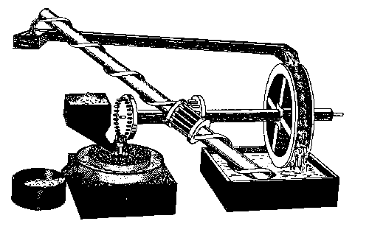
No 80/20 for the Halting Problem, same as for Perpetual Motion
There is no “80/20” engineering solution
No amount of testing or “fixing” will help
If someone is selling it, run away -- you don’t want to be around when it breaks
Notes:
MEREDITH

Slide 15
“The Hidden Recognizer”
These are language recognition problems, so Turing/Church MUST be used to settle them
The deadliest programming/design pattern: The Scattered Recognizer (“Shotgun parser”)
Checks for input validity are scattered throughout the program, mixed with processing logic
Implicitly/vaguely understood input languages: the mother of all Halting Problems
We’ll show exactly how the Turing Beast arises
Notes:
MEREDITH
“scattered parser”: mention it here, but
Explain “The Scattered Recognizer” – e.g. scattered through the code
Shotgun debugging is not your friend and neither is shotgun parsing

Slide 16
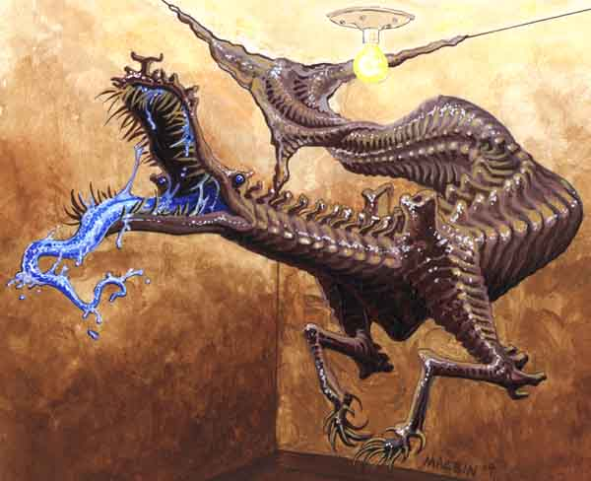
The Turing Beast
Notes:
SERGEY
“This is what the Turing Beast looks like”
The Turing Beast? /hound of Tyndalos/
(emerges from junctures, corners, angles, layer
boundaries)
(add OSI stack image to the Hound of Tyndalos pic)
"hackers have been exploring the geometry of these
angles and the biology of these beasts”
“this is what your OSI/protocol/application stack really looks like”
“get the angles right, call up the Beast”
“And now for some mostly harmless specimens” ->

Slide 17
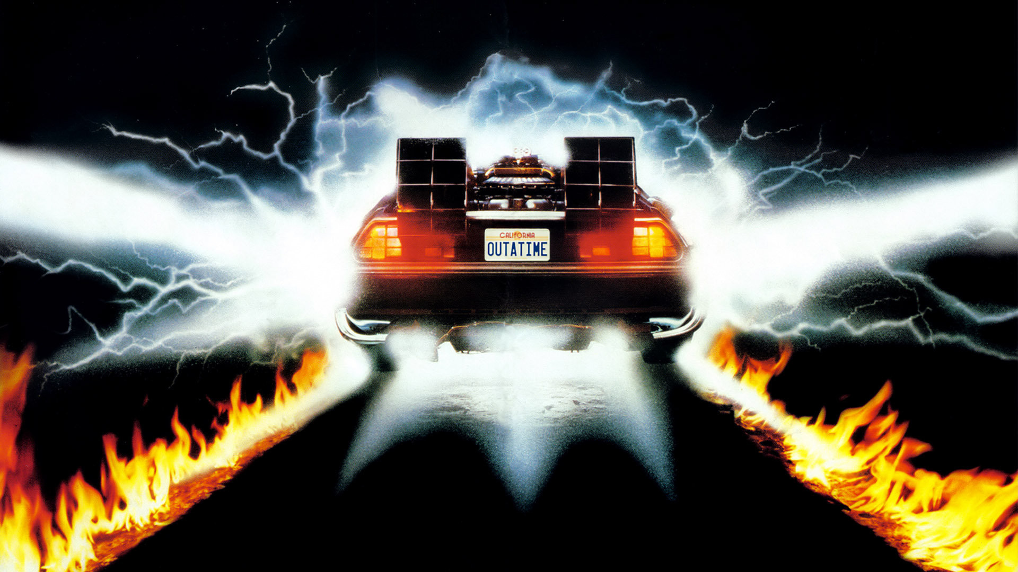
Back to the Turing Future to slay the Turing Beast!
Insecurity as related to computation must be understood from the Turing and Church basics of computation – but with exploit programming lessons in mind
Academics study models of computation
Hackers study actual computational limits of real systems
Notes:
SERGEY

Slide 18
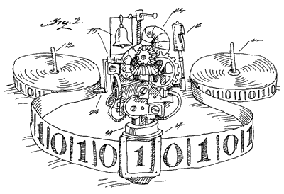
Turing machines and undecidability
Turing Machine: the model of computer to study the limits of what is computable
TM can do what your computer, phone, keyboard, NIC, … can do
Undecidable problems: No TM can solve them.
“The Halting Problem is Undecidable”
Notes:
SERGEY
AS: “of what is computable”
First you make a statement about what a Turing machine can do. Then you make a statement about what? Also Turing machine? Then you make statements about undecidable problems. Can we have some structure here, please?

Slide 19
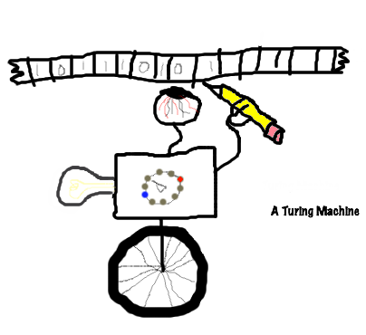
Cornerstone: the Halting Problem
“I can build a TM that takes another TM as input and decides if it will ever terminate”
{True, False}
Notes:
SERGEY
“There is no 80/20 engineering solution to the Halting Problem”, no more than for Perpetual Motion!
If someone is selling it, run away

Slide 20

Cornerstone: the Halting Problem
“I can build a TM that takes another TM as input and decides if it will ever terminate”
{True, False}
Notes:
SERGEY
“There is no 80/20 engineering solution to the Halting Problem”, no more than for Perpetual Motion!
If someone is selling it, run away

Slide 21
The history of the Uncomputable
Leibniz: “Can a machine determine truth values of mathematical statements”? [17th century]
Hilbert’s Entscheidungsproblem, [1928]
“Is an arbitrary logical statement valid or invalid”?
Church [1936], Turing [1937]: Negative!
Based on work by Kleene, Goedel [1930s]
Curry-Howard correspondence: programs are proofs and vice versa
Notes:
MEREDITH
Entscheidungsproblem – is an arbitrary logical statement valid or invalid?
Curry-Howard correspondence: programs are proofs and vice versa
AS: XVII -> 17th century?

Slide 22
Programs and exploits as proofs
Curry-Howard correspondence: programs are proofs and vice versa
Exploits are proofs too: by construction of unexpected/hostile computation
Formal Duality? <TBD>
Notes:
MEREDITH
SB: remove this slide? Later program⬄proof is re-iterated as exploit ⬄ program ⬄ proof.
Can duality be made formal/precise?
Nod at Andreas.

Slide 23
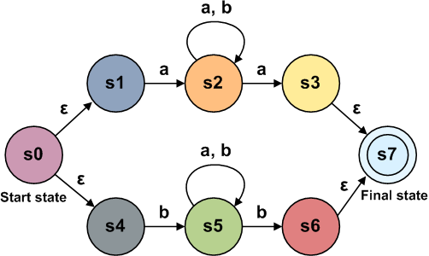
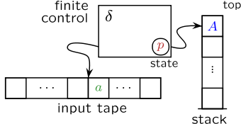
The right machine for a task (“mostly harmless”)
Matching regular expressions: finite state machines
a[ab]+a | b[ab]+b
Matching recursively nested structures: pushdown automata
((([({(…)})])))
Notes:
MEREDITH

Slide 24

The right machine for a task (2)
Telling data from metadata (“weakly context-sensitive” protocols, e.g., those with length fields)
Parsing an IP packet past a few corrupted bytes
Telling if input is a program that produces a given result: UNDECIDABLE (Rice’s Theorem)
?
Notes:
MEREDITH
4 is *in the general case* undecidable. If you can prove that your input is constrained to a lower class of language, you’re ok
Expand on length fields , give them a separate slide, show packet with length field, mention PIP.
Need context to tell data from metadata: important – show on packet
AS: What is displayed in the first bullet point? As in the previous slide, specify what kind of machine

Slide 25
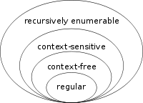

The language hierarchy
Notes:
MEREDITH

Slide 26
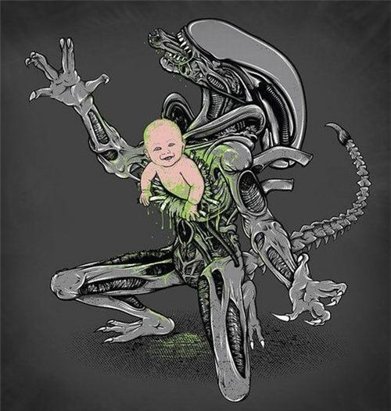
“Type I”: Input Handling
In-component, “The weird machine inside”
Notes:
SERGEY
“little baby shellcode, a dear little root shell”. Prepend slide reminding of one-component/multi-component?
AS: What’s up with the ‘I’ in the slide header?

Slide 27
Insecurity: “What is exploitation?”
Exploitation is unexpected computation
1119 sendmail: accepting connections 31337 \_ -bash 31338 \_ rm –rf /
Exploits are programs written in crafted inputs that cause unexpected computation in the target system
Programs for what machines? See Halvar Flake/Thomas Dullien talk @ Infiltrate 2011
Notes:
SERGEY
Curry-Howard applies to exploits too! Expand?

Slide 28
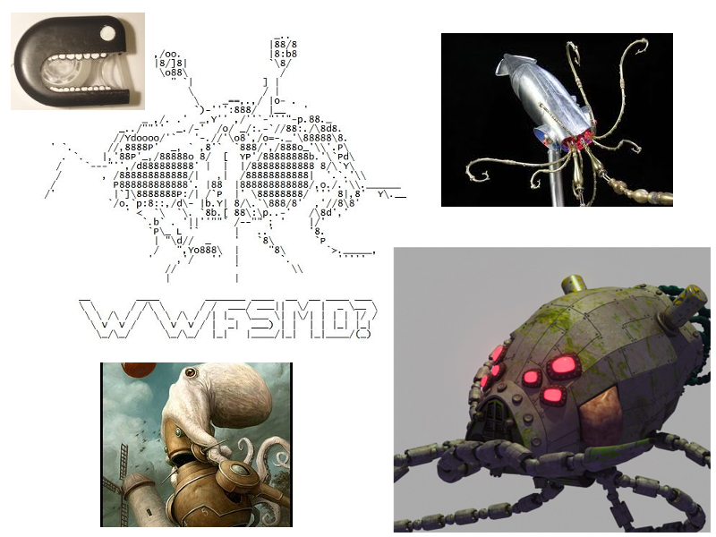
“Weird Machines”
Notes:
SERGEY

Slide 29
“Exploitation is setting up, instantiating, and programming a weird machine”
A part of the target is overwhelmed by crafted input and enters an unexpected but manipulable state
A “weird machine” is unleashed
Who let the dogs out?
Inputs drive unexpected computation
Notes:
SERGEY
“Inputs did it!”

Slide 30
Inside every program are weird machines waiting to break out
Wherever input is accepted and processed by ad-hoc code, bugs are likely
“Deviant inputs” cause memory corruption, type misinterpretation (e.g., signed vs unsigned integer overflow), etc.
“Primitive” corrupting inputs are combined into full exploit-programs
See gera, “About Exploits Writing”, 2002
Our upcoming article in ;login: December 2011
Notes:
SERGEY
“wherever input is accepted and handled is part of the attack surface”

Slide 31
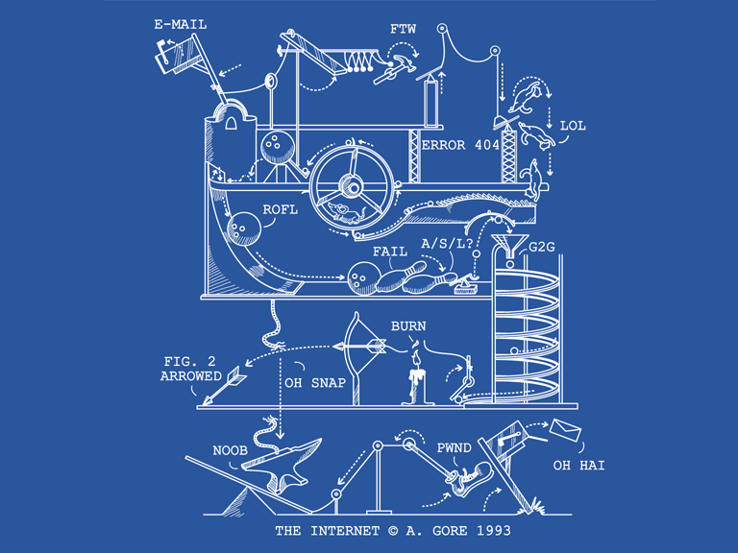
“Bugs to primitives to exploits”
Phrack 57:8
Phrack 57:9
Phrack 58:4
Phrack 59:7
Phrack 61:6
Notes:
SERGEY
Brief bib, names of authors?
Insert slide: “What can we do? Demand this:”

Slide 32
“Bugs to primitives to exploits”
Phrack 57:8 MaXX, Vudo malloc tricks
Phrack 57:9 Once upon a free()
Phrack 58:4 Nergal, Advanced return-to-libc exploits
Phrack 59:7 riq & gera, Advances in format string exploitation
Phrack 61:6 jp, Advanced Doug Lea’s malloc exploits
Notes:
SERGEY
MEREDITH – SET UP NEXT SLIDE “What can we do? Well, we don’t make demands, because terrorists make demands – but in solidarity with millions of angry people in the Middle East and the United States, we have some suggestions…”

Slide 33
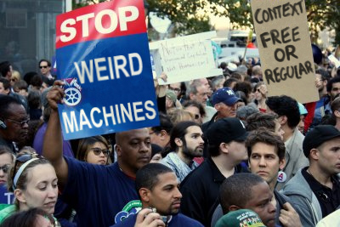
Occupy Input Handlers!
Notes:
MEREDITH
(move from left to right: We can stop weird machines by constraining input language strength, and we must constrain to context free or regular.)

Slide 34
Is it all about parser bugs?
No, but that’s a large chunk of it
Every program component that receives input from others has a recognizer for the language of valid or expected inputs
If the recognizer does not match the language, it is broken
If neither is well-defined or understood, the program is broken
Notes:
MEREDITH
SB: SQL Expanded on next slide

Slide 35
Languages are everywhere!
Network stacks: valid packets make a language
Stack is a recognizer at every layer/protocol
Servers: valid requests make a language
e.g. SQL injection is a recognizer failure
Memory managers: heaps make a language
Heap metadata exploits abuse its context-sensitivity
Function call flow: valid stacks make a language
Context-sensitivity again, which bytes are data, which are metadata?
Notes:
MEREDITH
Network stack processes packet, hands payload to next layer
SQL input handler parses queries, hands to analyzer
Memory manager operates on used/unused blocks, allocates to processes
Most of these are handrolled and that’s bad

Slide 36
An implicit recognizer is a bad recognizer
Ad-hoc recognizer logic scattered throughout the program is hard to test and debug
Lots of intermixed recognition/processing state => lots of unexpected states, data flows, and transitions (hello “weird machine”!)
Weird machines run on borrowed state
(cf. Halvar’s Infiltrate 2011 talk)
Don’t process what you cannot first recognize!
Notes:
MEREDITH
Mention “shotgun parsing” again
SB: First practical point: if you do not require rich parsing power, it will be hard to hijack by inputs

Slide 37
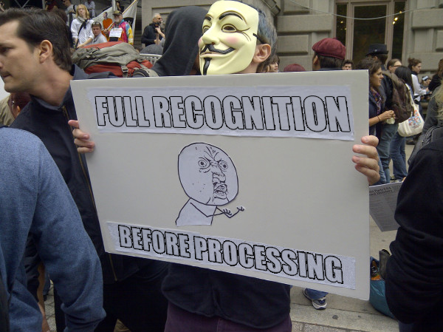
Occupy Program State!
Notes:
MEREDITH

Slide 38
Regard all valid/expected inputs as a formal language
Know and be strict about what your input language is
Know what computational power it requires to get recognized
Never parse nested structures with regexps!
Write the recognizer explicitly or, better, generate it from a grammar
Stay away from Turing-complete input languages
Notes:
MEREDITH
SB: IE8 anti-XSS was based on regexp rewriting, created vulns where none were before, predictably

Slide 39
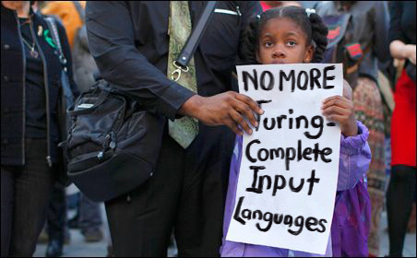
Occupy Message Formats!
Notes:
MEREDITH
SB: Don’t let the Turing Beast devour her safe computing future!
SB: If you are offered a product with Turing-complete macros/scripting/config languages, run like hell
Unless you mind spending money and (infinite) time to secure it (and bolt-on application firewalls will
not help, as we show later)

Slide 40
“Regular is a safe place to be”
Notes:
MEREDITH
SB: “the Turing Beast will eat your investment” if you leave it in that corner.

Slide 41
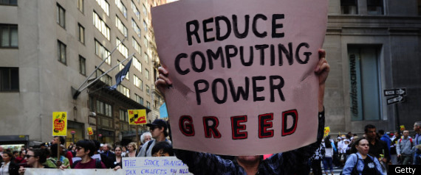
Occupy Protocol Design!
Notes:
MEREDITH
SB: “and keep the Turing Beast away” and from eating your investments

Slide 42
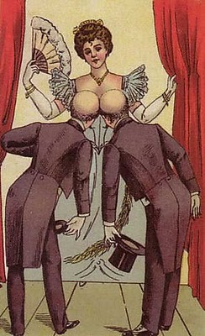

II. Composition & communication
Computational equivalence between components: “Are you seeing what I’m seeing?”
Notes:
SERGEY
“but the story does not end even if there is no shellcode chestburster”
It gets more interesting as more than one component is involved
AS: remove the II ? Nobody remembers where they saw I
Or, you could introduce structure by making an index of your slides

Slide 43
Insecurity: miscommunication
Today’s systems are distributed/composed, with many talking components
Parsers/recognizers are involved across every interface!
Notes:
SERGEY
Attn: integrators, aggregators – what part of IT industry is it? Big part.

Slide 44
Parser computational equivalence
Parsers involved in a protocol/exchange must parse messages exactly the same way
For X.509 SSL certs between CA and browser, formally required
Between a NIDS and its protected target, effectively required
Equivalence must be assured/tested
with automation tools, unit tests, integration tests
Notes:
SERGEY -> MEREDITH
Trust involved here
App firewalls too! Re-order items!
SSL is the largest trusted distributed system on the Internet (arguably) . People rely on it for serious, sometime vital things (repressive govt’s SSL MITMs?)

Slide 45
The X.509 Case Study
X.509’s Common Names (CN) : an ambiguous language, ad-hoc parsers =>
Certificate Signing Request (CSR) parsed differently by the signing CA and certificate consumer (e.g., browser) =>
Browser believes the CA signed this cert for google.com, ebay.com, paypal.com, …
20+ 0-day from Parser Differential Analysis
Sassaman, Patterson “Exploiting Forest with Trees”
ASN.1 BER ambiguous, considered harmful
Notes:
MEREDITH
X.509 (ASN.1) on separate slide. Mention BER/DER encoding
Ambiguous because underspecified – multiple CNs allowed but ordering rules not specified

Slide 46
Halting Problem, hello again
Testing computational equivalence for two automata recognizing regular languages (regular expressions) and deterministic pushdown automata is decidable
Tools/software automation can help
But for non-deterministic pushdown automata or stronger it is UNDECIDABLE
No amount of automated testing effort will give reasonable coverage
Notes:
MEREDITH
SB: stress tools, integration. Watch out for Turing-complete messaging in systems –
Extensibity benefit will be eaten up by security/control expenses, the Turing Beast will eat them!
Add icon of TB

Slide 47
The curious case of the IDS: moving the Halting Problem around
Trying to “fix” Input Recognition Halting Problem of a scattered and vaguely defined recognizer with another, “less vulnerable” component?
But it can’t be fixed! So a “fix” must backfire.
So you get the Endpoint Computational Equivalence Halting Problem between the IDS’ stack and the target’s input protocol handling!
Notes:
SERGEY
Untestable recognizer AS: What is going on here? Is this a call to Fix Input Recognition? Is this a claim that IDSes fix input recognition or fix input recognition halting problem?
Same about the second sentence

Slide 48
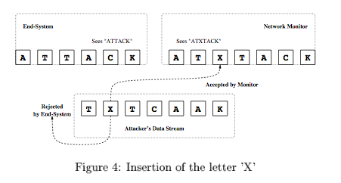
“Insertion, Deletion, Evasion” & other horsemen of the IDS/IPS Apocalypse
Ptacek & Newsham, 1998
Vern Paxson, 1999--…
Notes:
SERGEY
Really, the IDS/IPS apocalypse – or, restore “Digital Apocalypse”?

Slide 49
“Conservation of (bad) computational power”
Computational power once created cannot be destroyed
“Dark energy” of scattered parsers will resurface
You have not fixed the Halting Problem due to input language complexity, you just converted it into another Halting Problem
Notes:
SERGEY

Slide 50
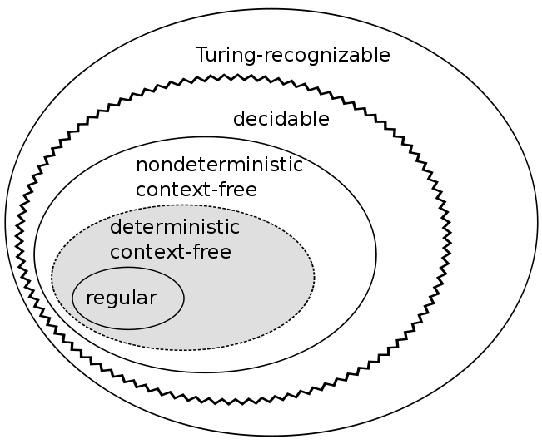
Stay away from the Halting Problem
Choose the simplest possible input language, preferably regular or at most deterministic context-free
Notes:
MEREDITH

Slide 51
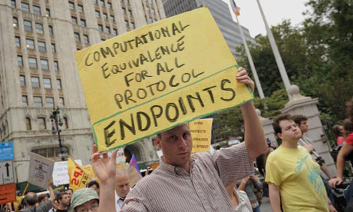
Occupy the IETF!
Notes:
MEREDITH

Slide 52
Time to re-evaluate Postel’s Principle?
“Be conservative in what you send; be liberal in what you accept.”
-- it made the Internets happen and work
-- its misreadings made the Internets the way they are now
Postel’s Principle needs a patch:
Sassaman & Patterson, PhNeutral, March 2010
Dan Geer, “Vulnerable Compliance” ;login: December 2010 (free online)
Notes:
MEREDITH
SB: Mention Dan Geer “Vulnerable Compliance” ;login: Dec 2010 (now free online)

Slide 53
The Postel’s Principle Patch
- Be liberal about what you accept
+ Be definite about what you accept
+
+ Treat inputs as a language, accept it with a
+ matching computational automaton, generate its
+ recognizer from its grammar.
+
+ Treat input-handling computational power as privilege,
+ and reduce it whenever possible.
Notes:
MEREDITH

Slide 54
Take-away?
Good protocol designers don’t allow their protocols to grow up to be Turing-complete
Ambiguity is Insecurity!
If your application relies on a Turing-complete protocol, it will take infinite time to secure it
Rethink Postel’s Law
Notes:
MEREDITH
SB: Add another slide: money in pocket:
"Do not mistake complexity for functionality".
Saving money on future upgrades thanks to
"extensibility"? See that you
are not losing it on security/mediation/controls,
eaten up by the Turing Beast.
"This system is very extendable/updatable
because it embeds macros/scripting/programming
language in data" -- run like hell
Practical value:
1. Saves mis-investment of money
and effort; exposes vendors that claim
security based on solving perpetual motion.
2. Helps pick the right components and ties
to have manageable security.
3. Helps avoid system aggregation/intergration
nightmares scenarios (and these are many:
FBI Virtual Case File, health care integration just
waiting to happen?)
Mention Interpolique as practical positive example
"There is no 80/20 engineering solution" to
the Halting Problem”

Slide 55
Money talks
Language-theoretic approach helps to
save mis-investment of money and effort,
expose vendors that claim security based on solving perpetual motion,
pick the right components and protocols to have manageable security,
avoid system aggregation/integration nightmare scenarios.
Notes:
SERGEY
FAIL: FBI Virtual Case File, health care integration just waiting to happen?

Slide 56
Do not mistake complexity for functionality
Saving money on future upgrades thanks to Turing-complete "extensibility"? See that you are not going to lose more on security/mediation/controls, eaten up by the Turing Beast.
"This system is very extendable/updatable because it embeds macros/scripting/programming language in data" -- run like hell

Slide 57
Occupy Input Handling!
“Stop Weird Machines”
“No More Turing-complete Input Languages!”
“Reduce Computing Power Greed!”
“Ambiguity is Insecurity!”
“Full recognition before processing!”
“Computational equivalence for all protocol endpoints!”
“Context‐free or Regular!”

Slide 58
Thank you!
http://langsec.org
http://langsec.org/occupy/

